Slide 1


Project Title: Security DMZ
(Demilitarized Zone)
Duration: 01/08/2025 – 31/08/2025 Organization: Sunbeam Institute Of Information Technology
Submitted by: Neha Sanjay Kumbharde

Slide 2

Agenda / Roadmap
Day 1 (04/08/2025): Database & Web Server Setup
Day 2 (05/08/2025):Flask App with SSL
Day 3 (06/08/2025): Mail Server Setup
Day 4 (07/08/2025): Webmail Setup
Day 5 (11/08/2025):Monitoring with Nagios XI
Day 6 (13/08/2025):IDS with Snort
Day 7 (18/08/2025): Hardening & Firewall

Slide 3
Technologies Used:-
1)Database Server – MySQL/MariaDB:
The database server was set up by installing the required database software from the package manager.
A new database schema was created for the project, and user access privileges were assigned so only the web server could connect.
This ensured secure storage of application data and restricted access.
2)Web Server – Apache2 + Flask:
A web server environment was prepared using Apache2 to handle HTTP requests. Flask, a lightweight Python framework, was added to run the application logic.
The application was then cloned from the project repository and deployed on the server.
Configuration changes were made so that the application could connect to the database server and be accessed from client browsers.
3) SSL/TLS Certificates:
A domain name was mapped to the web server using local DNS/hosts file entries. A self-signed SSL certificate was generated and applied to the web server.
This enabled secure HTTPS communication between users and the application, protecting sensitive data during transmission.

Slide 4
Technologies Used:-
4)Mail Server – Postfix + Dovecot:
A mail server environment was created using Postfix for sending emails and Dovecot for receiving and storing them.
The mail server was configured with the organization’s local domain.
User accounts were created to allow testing of sending and receiving emails. This provided a functional internal email system for the project environment.
5)Webmail – Roundcube:
Roundcube was set up as a webmail client so that emails could be accessed through a web browser. The interface was connected to the mail server’s database and configured with the local domain.
This allowed users to log in with their mail IDs and send or receive emails directly through the browser.
6)Monitoring – Nagios XI:
A dedicated monitoring server was installed and configured with Nagios XI. Web and mail servers were added as monitored hosts.
Key services like HTTP, HTTPS, SMTP, IMAP, and system resources (CPU, memory) were tracked.
Notification alerts were enabled through the mail server, ensuring that administrators received warnings if any service failed.

Slide 5
Technologies Used:-
7)Intrusion Detection – Snort:
Snort was deployed on the web server as a network intrusion detection system.
It was configured to monitor incoming traffic and identify suspicious patterns such as SYN floods, ICMP floods, and abnormal packets.
Custom rules were added to detect common attack types, allowing early identification of potential threats.
8)System Hardening – Fail2ban:
Fail2ban was installed on all servers to prevent brute-force login attempts. The system monitored failed login attempts on services like SSH.
Malicious IP addresses were automatically blocked for a period of time after repeated failures. This provided an extra layer of protection against unauthorized access.

Slide 6
Technologies Used:-
9)System Hardening – iptables:
The database server was further secured using firewall rules.
Only the web server’s IP address was permitted to connect to the database service. All other connections to the database port were denied, reducing the attack surface.
10.Firewall – pfSense:
A pfSense firewall was deployed on a separate virtual machine to control network traffic.
Firewall rules were defined to allow only the necessary services: HTTP/HTTPS access to the web server
Mail services (SMTP, IMAP, POP3) to the mail server SSH access restricted to administrative systems only
This created a strong network perimeter, ensuring only trusted traffic could pass through.

Slide 7
Tools / Software Used:-
Day 01 – Web & Database setup:
a)Git → to clone the application repository.
b)Flask (Python) → web application framework.
c)Apache2 / Nginx (optional, if used as reverse proxy for Flask).
d)MySQL / MariaDB / PostgreSQL → database server (depending on the app requirements).
Python3, pip, virtualenv → for setting up Flask app dependencies.
Day 02 – Flask app domain & certificates:
a)Flask app (todo.sunbeam.local) → running web app.
b)OpenSSL → to generate SSL/TLS certificates.
c)Apache2 / Nginx → web server configuration with HTTPS (reverse proxy to Flask).
Day 03 – Mail Server:
a)Postfix → SMTP mail transfer agent.
b)Dovecot → IMAP/POP3 mail delivery agent.
c)Bind9 / dnsmasq (optional) → DNS for sunbeam.local domain resolution.

Slide 8
Tools / Software Used:-
Day 04 – Webmail:
a)Roundcube / SquirrelMail / Rainloop → webmail client.
b)Apache2 / Nginx → to serve webmail (http://mail.sunbeam.local).
Day 05 – Monitoring with Nagios:
a)Nagios XI → monitoring tool for services & resources.
b)Nagios plugins → for monitoring http, https, apache2, smtp, imap, pop3, cpu, memory.
c)Mail server (Postfix/Dovecot) → to receive Nagios alerts via email.
Day 06 – IDS with Snort
a)Snort → Intrusion Detection/Prevention System (IDS/IPS).
b)Custom Snort rules → for SYN flood, ping flood, ping of death detection.
Day 07– System Hardening & Firewall
a)Fail2ban → to protect SSH (scans logs and blocks malicious IPs).
b)iptables (netfilter) → firewall rules on DB server (restrict DB access).
c)pfSense → open-source firewall/router (FreeBSD-based).

Slide 9
Day1: Database & Web Server Setup
A Web Server is a machine that delivers web pages or applications to users over the internet or intranet. Common web servers are Apache, Nginx, IIS, or LiteSpeed.
Steps to Configure a Web Server:
Install Operating System – Typically Linux distributions or Windows Server.
Install Web Server Software – e.g., Apache, Nginx, or IIS.
Deploy Web Application Code – Place website files (HTML, CSS, PHP, Python, etc.) in the server’s root directory.
Connect to Database Server – Configure the application to connect with the database server for dynamic content.
DNS & Domain Setup – Point a domain name to the web server’s IP address.
Networking Configuration – Open ports (HTTP – 80, HTTPS – 443).
SSL/TLS Security – Install SSL certificates for secure connections.
Performance Tuning – Enable caching, load balancing, and compression.
Monitoring & Logging – Track server performance and access/error logs.
Example: A web application hosted on Apache that communicates with the MySQL database server to serve dynamic pages.

Slide 10

Day 02 – Flask App with SSL
I configured the Flask app to be accessible at https://todo.sunbeam.local.
I generated self-signed SSL certificates for this domain and updated the Apache/Flask configuration to use HTTPS.
Verified secure access over HTTPS.
Key Point: Knowledge of SSL/TLS and securing web apps.

Slide 11
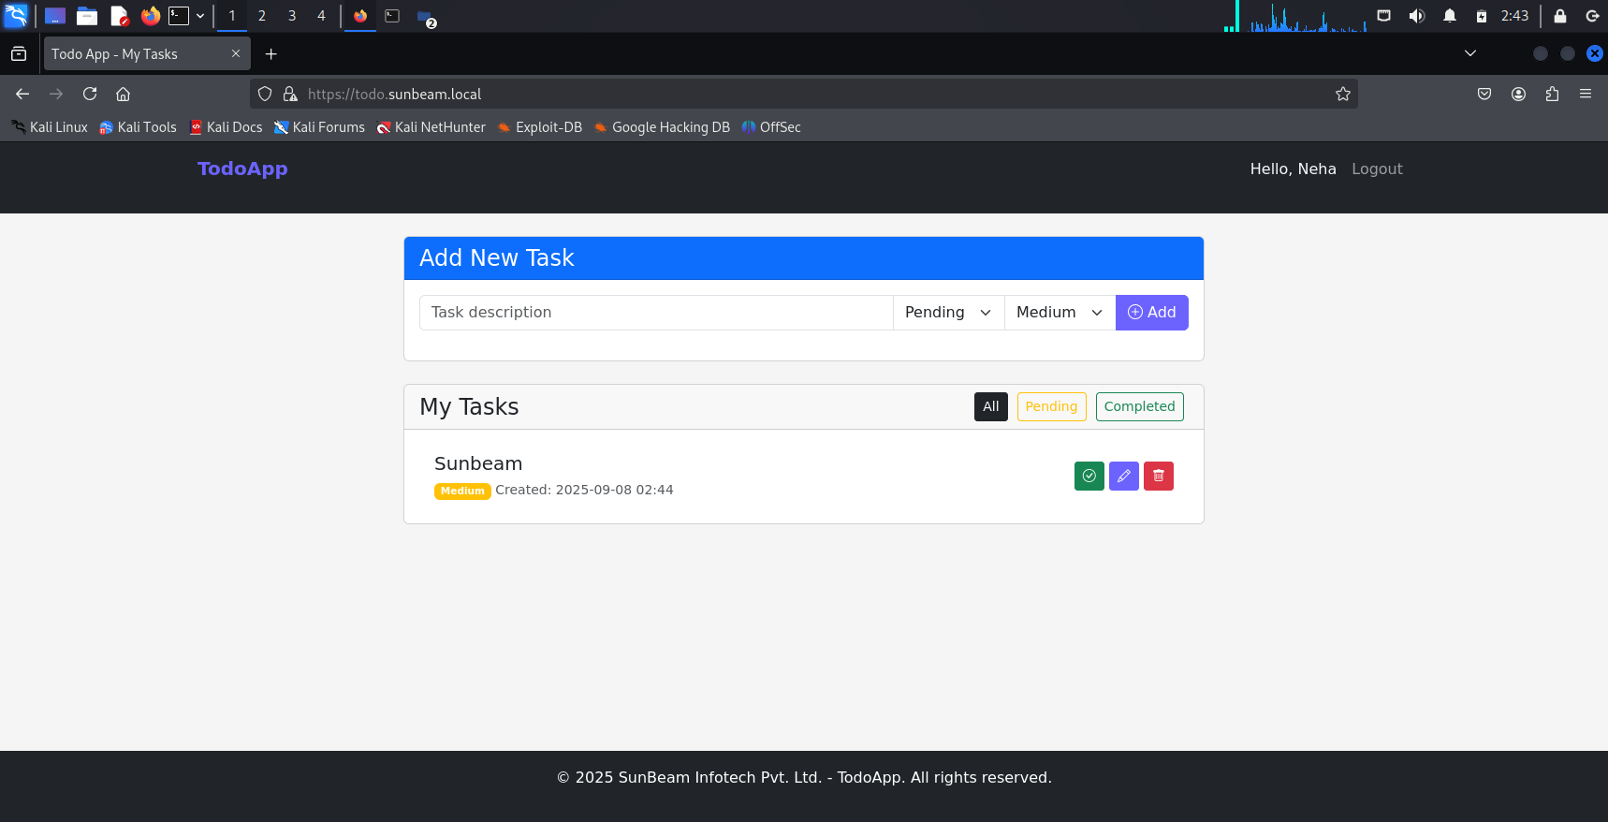
Engaging the audience
Make eye contact with your audience to create a sense of intimacy and involvement
Weave relatable stories into your presentation using narratives that make your message memorable and impactful
Encourage questions and provide thoughtful responses to enhance audience participation
Use live polls or surveys to gather audience opinions, promoting engagement and making sure the audience feel involved

Slide 12
Day 03 – Mail Server Setup
I installed and configured a Mail Server (Postfix + Dovecot) for the domain sunbeam.local.
Created and tested two user accounts to ensure sending and receiving emails was working.
Key Point: Experience in configuring email infrastructure.

Slide 13
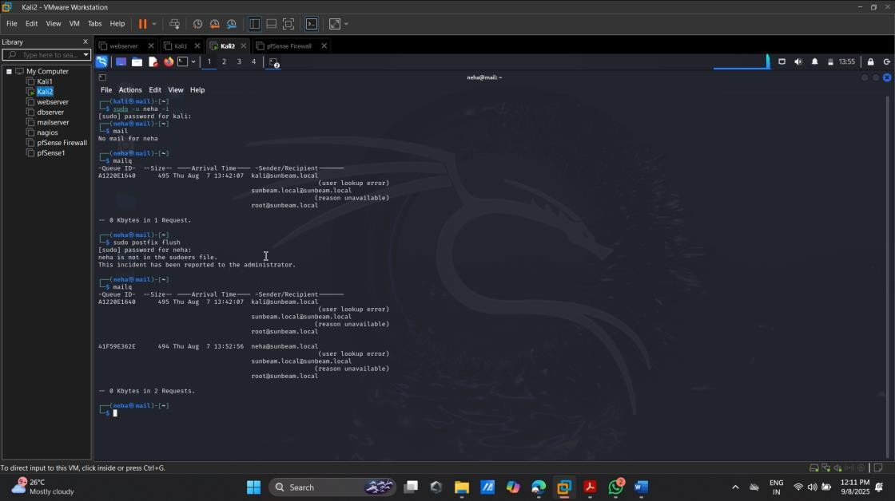

Slide 14
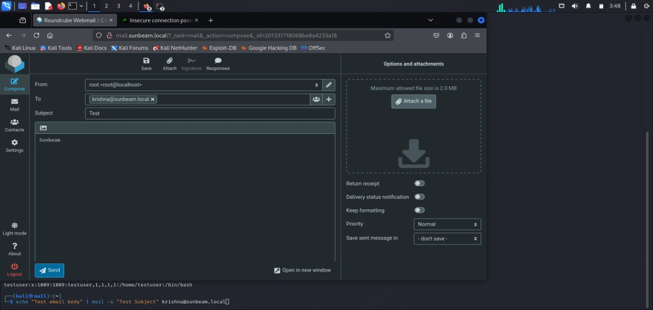
Day 04 – Webmail Setup
Installed Roundcube webmail and configured it to integrate with the mail server.
Made it accessible at http://mail.sunbeam.local.
Tested email login and communication via the browser.
Key Point: Practical email + webmail setup.

Slide 15

Day 05 – Monitoring with Nagios XI
Installed Nagios XI for monitoring Web Server and Mail Server.
Configured checks for Apache (HTTP/HTTPS), mail protocols
(SMTP, IMAP, POP3), and also system resources
(CPU, memory usage).
Configured email alerts from Nagios to be sent using our
mail server (sunbeam.local).
Key Point: Proactive monitoring & alerting setup.

Slide 16
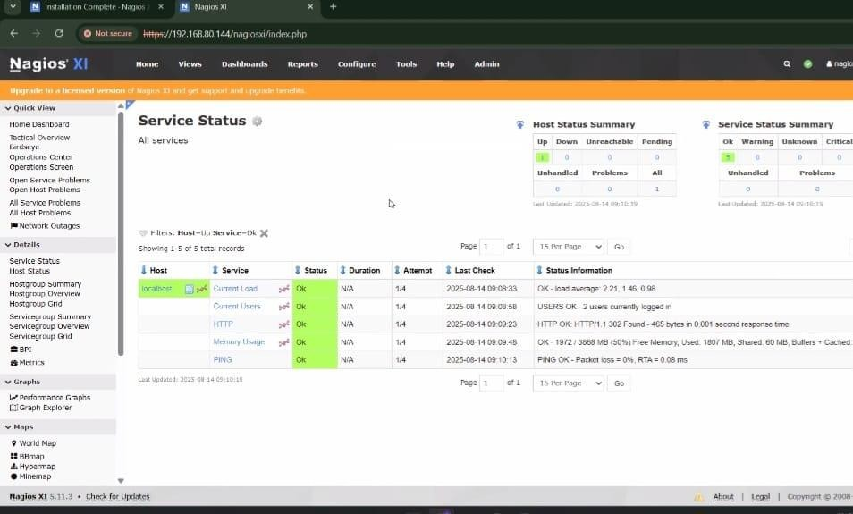

Slide 17
Day 06 – IDS with Snort
Objective:
Configure Snort on Web Server.
Write custom IDS rules.
Installed and configured Snort IDS on the web server.
Key Point: Shows knowledge of security & IDS rules.
Wrote custom rules for detecting:SYN FloodPing FloodPing of Death
a) SYN FloodPing
b)Flood
c) Ping of Death
Verified rules by simulating attacks and checking Snort logs.

Slide 18
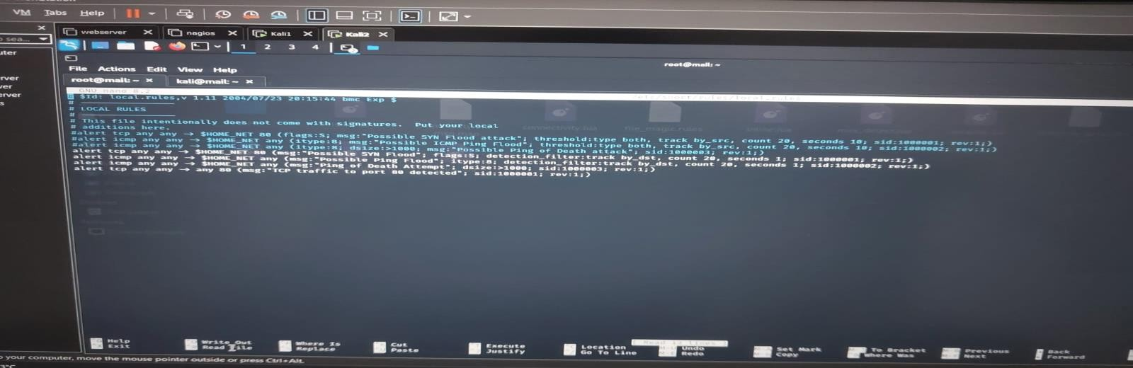

Slide 19
Day 07 – Hardening & Firewall
Objective:
Protect all servers with fail2ban.
Secure DB server using iptables.
Install and configure pfSense firewall.
Tasks:
Fail2Ban for SSH protection
iptables on DBserver (allow only Webserver access)
pfSense firewall installation & configuration

Slide 20
Thank you
Neha Sanjay Kumbharde
nehakumbharde1999@gmail.com

